Slide 1
Java Stream: Basics
Swedbank@ IT Academy 2020
Karolis Grigonis

Slide 2

JVM, JRE, JDK Naming conventions Data types Variables and variable modifiers Java keywords Java operators Control statements Java loops
Today’s agenda:

Slide 3
Goals for today
Learn Java language basics
Learn Java coding conventions
Get familiar with IntelliJ IDEA

Slide 4
Initial setup
Setup IntelliJ IDEA
Create your first project
Create main method
Read arguments from console
Display arguments in console

Slide 5
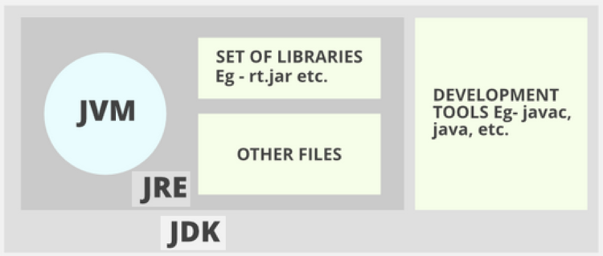
JVM, JRE, JDK
JVM (Java virtual machine) – is a virtual machine that enables a computer to run Java programs as well as programs written in other languages that are also compiled to Java bytecode.
JRE (Java Runtime Environment) – It is a package of everything necessary to run a compiled Java program, including the Java Virtual Machine (JVM), the Java Class Library, the java command, and other infrastructure.
JDK (Java Development Kit) – The full-featured SDK (Software Development Kit) for Java. It has everything the JRE has, but also the compiler (javac) and tools (like javadoc and jdb). It is capable of creating and compiling programs.

Slide 6
Naming conventions
Case Sensitivity − Java is case sensitive, which means identifier Hello and hello would have different meaning in Java.
Class Names − For all class names the first letter should be in Upper Case. If several words are used to form a name of the class, each inner word's first letter should be in Upper Case. Example: class MyFirstJavaClass
Method Names − All method names should start with a Lower Case letter. If several words are used to form the name of the method, then each inner word's first letter should be in Upper Case. Example: public void myMethodName()
Program File Name − Name of the program file should exactly match the class name. When saving the file, you should save it using the class name (Remember Java is case sensitive) and append '.java' to the end of the name (if the file name and the class name do not match, your program will not compile). Example: Assume 'MyFirstJavaProgram' is the class name. Then the file should be saved as 'MyFirstJavaProgram.java'
Package – All packages must be lowercase and separated by dot. Example: com.swedbank.itacademy.java.basics
https://en.wikipedia.org/wiki/Naming_convention_(programming)#Java

Slide 7
Java keywords
Java keywords are also known as reserved words. There are 51 of them. Keywords are particular words which acts as a key to a code. These are predefined words by Java so it cannot be used as a variable or object name. Some more common keywords are:
throws | class | extends | if | null
case | else | final | import | package
catch | default | finally | implements | public
break | enum | for | new | return
static | switch | this | while | try
https://en.wikipedia.org/wiki/List_of_Java_keywords

Slide 8
Main
public static void main(String args[]) − Java program processing starts from the main() method which is a mandatory part of every Java program.

Slide 9
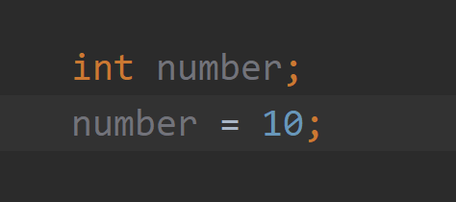
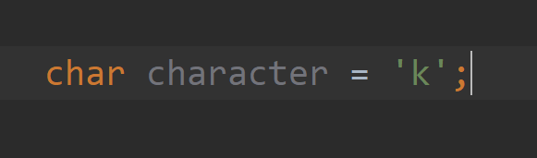
Variables
Variables are containers for storing data values. In Java, there are different types of variables, for example:
String - stores text, such as "Hello". String values are surrounded by double quotes
int - stores integers (whole numbers), without decimals, such as 123 or -123
float - stores floating point numbers, with decimals, such as 19.99 or -19.99
char - stores single characters, such as 'a' or 'B'. Char values are surrounded by single quotes
boolean - stores values with two states: true or false
Variable has to be declared if you want to use it for example:

Slide 10
Variables (methods and classes)
Local variables - are declared in methods, constructors, or blocks. Local variables are created when the method, constructor or block is entered and the variable will be destroyed once it exits the method, constructor, or block.
Instance variables - declared in a class, but outside a method. When space is allocated for an object in the heap, a slot for each instance variable value is created. Instance variables hold values that must be referenced by more than one method, constructor or block, or essential parts of an object's state that must be present throughout the class.
Class variables - also known as static variables are declared with the static keyword in a class, but outside a method, constructor or a block. There would only be one copy of each class variable per class, regardless of how many objects are created from it.

Slide 11
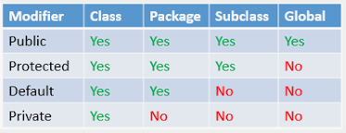
Access control modifiers
Visible to the package, the default. No modifiers are needed.
Visible to the class only (private).
Visible to the world (public).
Visible to the package and all subclasses (protected).

Slide 12
Non-access modifiers
static – for creating class methods and variables.
final – for finalizing the implementations of classes, methods, and variables.
abstract – for creating abstract classes and methods.
synchronized and volatile – which are used for threads.

Slide 13
Data types
Data types are divided into two groups:
Primitive data types - includes byte, short, int, long, float, double, boolean and char
Non-primitive data types - Objects
Primitive type | Wrapper Class
boolean | Boolean
byte | Byte
char | Character
float | Float
int | Integer
long | Long
short | Short
double | Double

Slide 14
Arrays
Arrays are used to store multiple values in a single variable, instead of declaring separate variables for each value.
String[] cars = new String[4]; cars[0] = "Volvo"; cars[1] = "BMW"; cars[2] = "Ford"; cars[3] = "Mazda";
String[] cars = {"Volvo", "BMW", "Ford", "Mazda"};

Slide 15
Java operators
There are six groups of operators:
Arithmetic Operators – are used in mathematical expressions to do various calculations. +, -, *, /, %
Relational Operators – are used to compare two or more values. ==, !=, >, <, >=, <=
Logical Operators – are used to determine the logic between variables or values !, &&, ||
Assignment Operators – are used to assign values to variables. =, +=, -=, *=, /=, %=
Unary Operators – are used with only one operand. +, -, ++, --, !
Bitwise Operators – are used to perform operations on individual bits. ~, <<, >>, >>>, &, ^

Slide 16
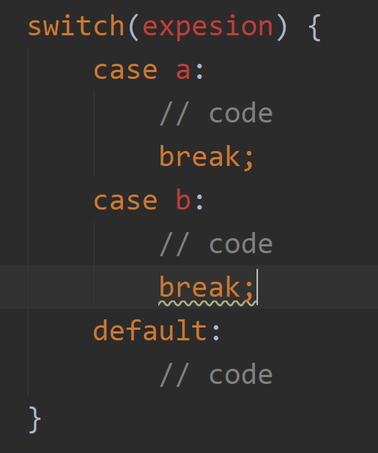
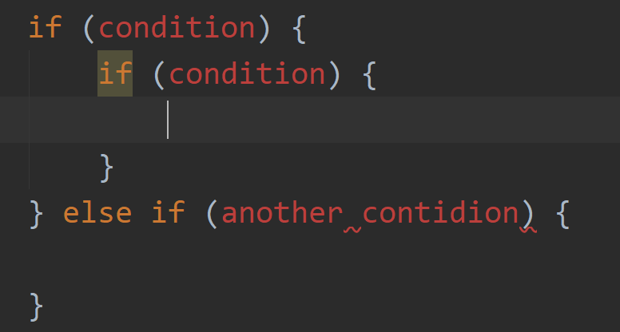
Control statements
Control statements are used to do decisions and execute different code based on some sort of logic.
if, if-else, nested if – these control statements use logical operators to evaluate values and execute code blocks based on the evaluation result.
switch – this control statement is used when there is a predefined set of cases that you will have in your code and you want to execute a different code blocks based on the case. Switch evaluates expression only once.

Slide 17
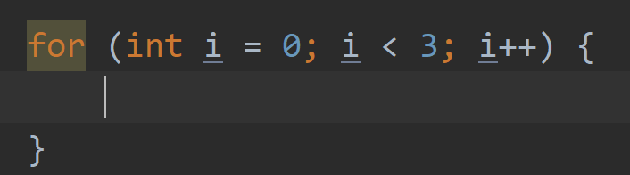
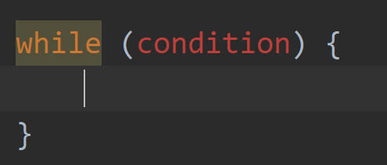
Java loops
Loops in Java are used when you need to execute same code block for a certain amount of times of until a condition is satisfied.
for loop – this loop is used when you know how many times you need to run your code block.
while loop – this loop is used when you want to run your code block until your condition is satisfied.

Slide 18
Tasks

Slide 19
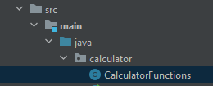
Task 0
Prerequisites:
Clone project: https://github.com/JurgisSi/java-calculator.git
Task:
Implement calculator functions

Slide 20
Task 1
Prerequisites:
Create package named lt.itacademy.java.basics
Create class named Basics with main method to execute your program.
Task:
From console input read three variables your name, surname and age. Concatenate them together with “Hello I am” and “I am attending IT Academy 2020!”
Input: Karolis Grigonis
Output: Hello I am Karolis Grigonis. I am attending IT Academy 2020!
Tip:
Scanner scanner = new Scanner(System.in); String input = scanner.nextLine();

Slide 21
Task 2
Prerequisites:
Continue in the same Basics class.
Task:
Create all of the primitives (except long and double) with different values. Concatenate them into a string and print it to the screen.
Output: H3110 w0r1d 2.0 true

Slide 22
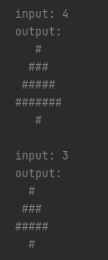
Task 2.1 (bonus)
Prerequisites:
Create class named Art.
Task:
Draw a happy little tree in console with given height.

Slide 23
Task 3
Prerequisites:
Create class named Arithmetics in the same package as before with main method to execute your program.
Task:
Calculate cube’s volume and perimeter.
Input: 5
Output:
Cube’s volume: 125cm3.
Cube’s perimeter: 30cm.

Slide 24
Task 4
Prerequisites:
Continue in the same Arithmetics class.
Task:
Create a method which converts feet and inches to centimeters. It needs to have two parameters. First parameter is feet and second is inches.
Hint: 1 inch = 2.54cm and 1 foot = 12 inches
Input: 2.4 4
Output: 2.4 feet and 4.0 inches = 5,083,312000 cm

Slide 25
Task 5
Prerequisites:
Create class named Operators in the same package as before with main method to execute your program.
Task:
Create a method which determines whether triangle is Equilateral (has three equal sides), Isosceles (has two equal sides), Scalene (has no equal sides) or is invalid. Program takes 3 input values (triangle sides).
Input: 8 8 8
Output: Triangle is Equilateral. Sides: 8 8 8
Input: 1 3 5
Output: Triangle is invalid. Sides: 1 3 5

Slide 26
Task 6
Prerequisites:
Continue in the same Operators class.
Task:
Create a method which determines whether a car will be able to drive to the destination or not. In case if car is not able to drive. Print out how much fuel does it need to fill the tank more to be able to drive to the destination as well as how much will it cost. If it is able to drive to the destination write how much fuel will it have left on the tank. Program has four parameters: distance to the destination, how much fuel does the car have in the tank, car fuel usage per 100km and fuel price per liter.
Input (negative flow): 100 6 7 1.25
Output: Destination is in 100km. Car is not able to reach the destination. It needs 1 liter of fuel more. It will cost 1.25.
Input (happy flow): 110 25 7 1.25
Output: Destination is in 110km. Car is able to reach the destination. It will have 17.3 liters of fuel left.

Slide 27
Task 7
Prerequisites:
Create class named Loops in the same package as before with main method to execute your program.
Task:
Create a method which calculates how many hours and minutes are in one year (365 days). You must use for loop to get the answer. You can’t just multiply days and hours. Only one input is required days per year.
Input: 365
Output: There are 8760 hours or 525600 minutes in one year.

Slide 28
Task 8
Prerequisites:
Continue in the same Loops class.
Task:
Refactor you for loop into while loop. You should get the same output as in Task 7.
Input: 365
Output: There are 8760 hours or 525600 minutes in one year.

Slide 29
Task 9
Prerequisites:
Continue in the same Loops class.
Task:
Choose while or for loop and calculate factorial of a number. Your program should take an integer number and calculate it’s factorial and output response to the console.
Input: 5
Output: Factorial of number 5 is 120.

Slide 30
Task 10
Prerequisites:
Create class named Calculator in the same package as before with main method to execute your program.
Task:
Using what you have learned create a calculator which will calculate figures perimeter and area. You must use switch statement for choosing a figure. Program should run as long as you want to continue using calculator. This means that after calculations are done it must ask if you want to run it again. You must check whether input values are correct if not write an error message that values were incorrect. Calculator must be able to calculate Triangle, Rectangle and Square perimeter and area.
Input (happy flow): Rectangle 5 7
Output: Rectangle perimeter is 24 and area is 35.
Input (negative flow): Rectangle 0 7
Output: Rectangle edge can’t be 0.

